Slide 1


Lab In Data Analysis
Avishay Bar | 316165984
Liad Garbois | 206714958

Slide 2





Road Map
Introduction
Dataset Overview
Data Preparation and Cleaning
Box Plots
Violin Plots

Slide 3
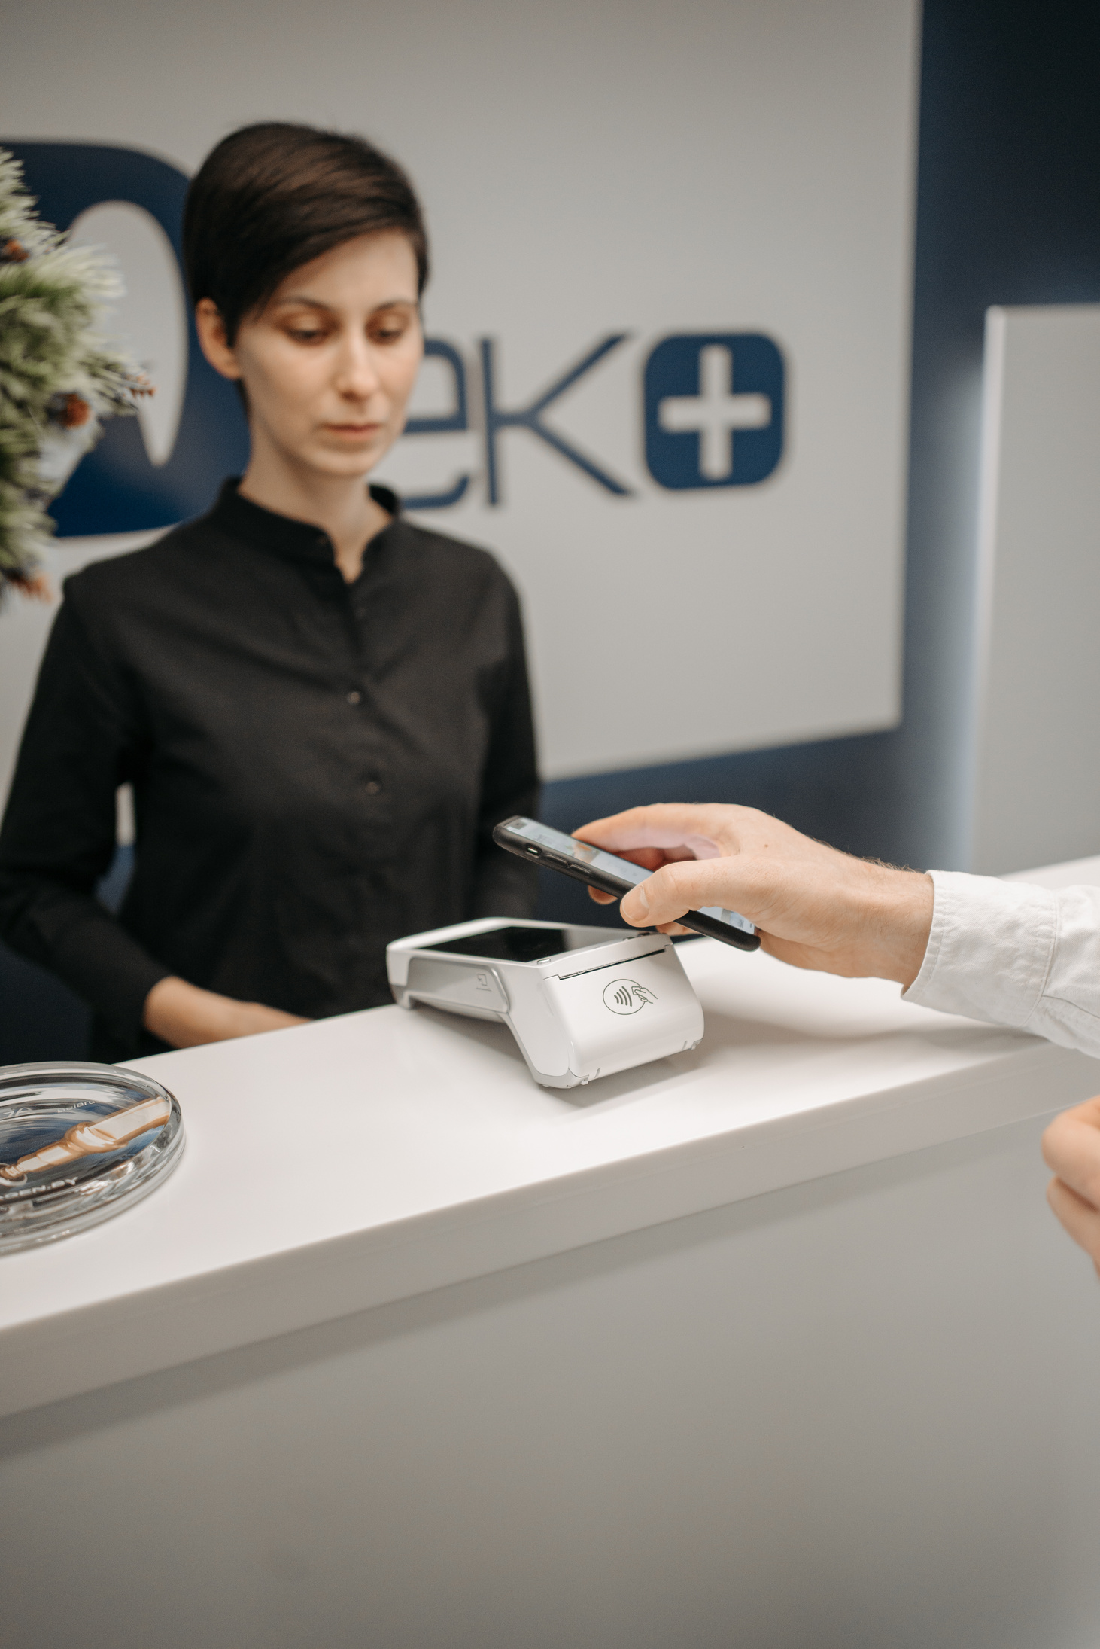


Introduction
After the COVID-19 pandemic, mobile phones and laptops became essential tools for everyone, regardless of their occupation.
Many brands produce laptops and mobile phones, each featuring its own unique processor.
Nowadays, social media influencers earn a living using only their mobile phones and laptops. Moreover, these devices store much of people's sensitive and personal information.
Consumers often choose devices based on memory specifications, making it a key factor in purchasing decisions. Cloud services help, but many users still prefer ample local storage for speed, privacy, and offline access.

Slide 4
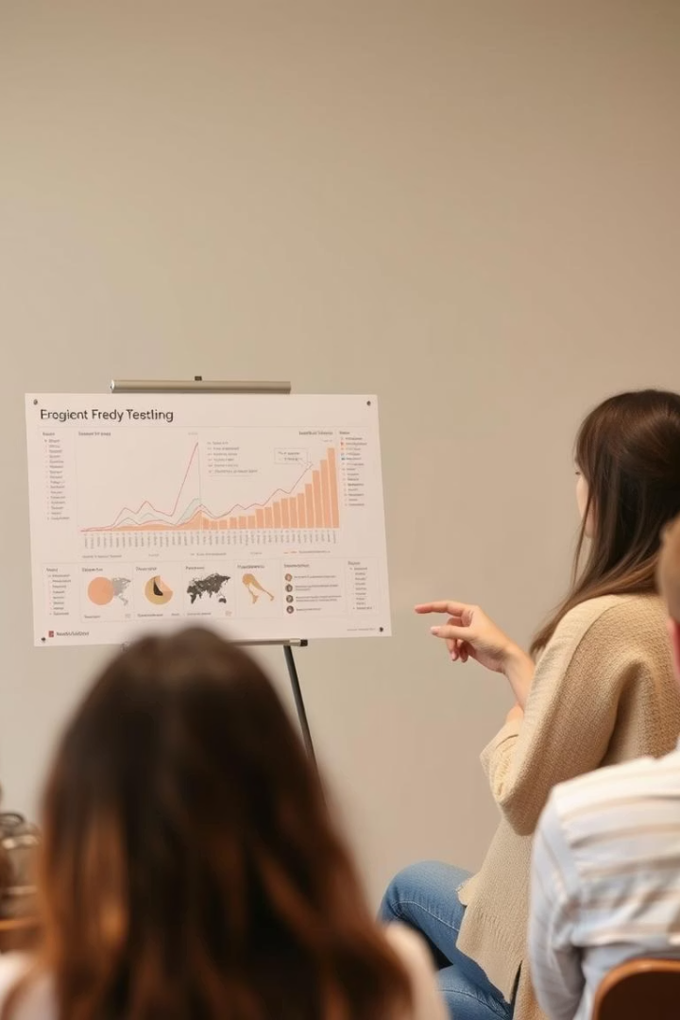


Dataset Overview
Dataset Theme
Simulated sales transactions for mobile phones and laptops
Data Included
Product specifications, Customer details and Sales information
Size
50,000 rows and 16 columns.

Slide 5

Dataset Overview
Product Information
Product
Brand
Product Code
Product Specification
Type of product (Mobile Phone / Laptop).
Various brands like Apple, Samsung, Dell, Lenovo, OnePlus, etc.
Unique identifier for each product.
Brief description of the product features.

Slide 6
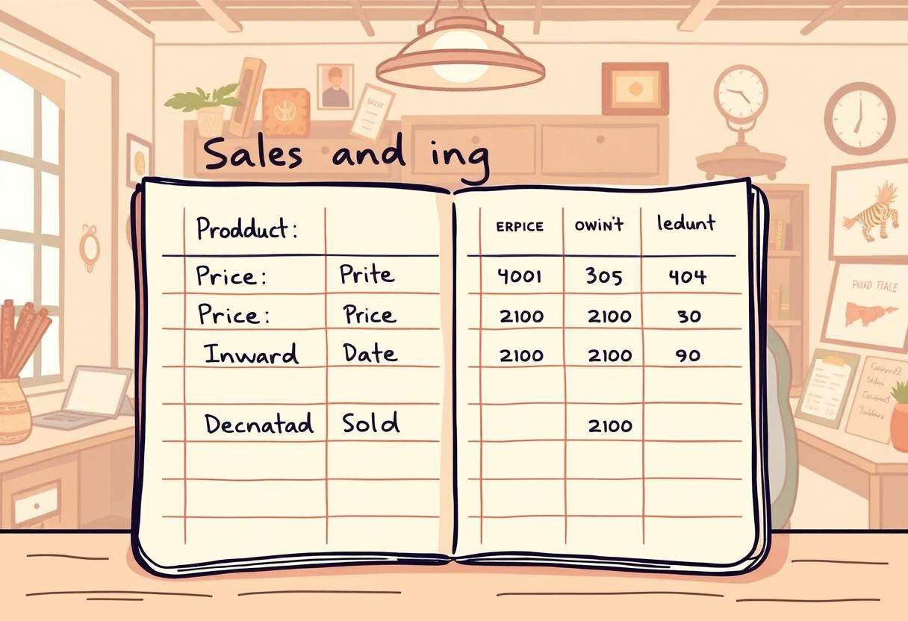
Dataset Overview
Sales & Pricing Details
Price
Inward Date
Dispatch Date
Quantity Sold
Cost of the product (randomly generated).
Date when the product was received in stock.
Date when the product was sold/dispatched.
Number of units sold per transaction.

Slide 7
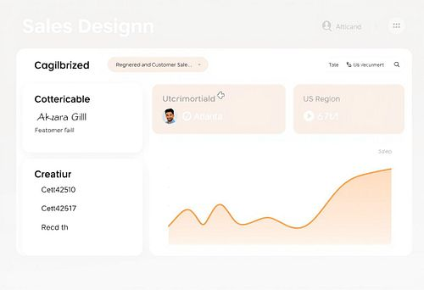
Dataset Overview
Customer & Location Details
Customer Name
Customer Location
Region
Randomly generated customer names.
City of the customer.
Sales region (North, South, East, West, Central).

Slide 8

Dataset Overview
Technical Specifications
Core Specification
Processor Specification
RAM
Includes processor models like i3, i5, i7, i9, Ryzen 3-9 (For Laptops).
Includes processors like Snapdragon, Exynos, Apple A-Series, and MediaTek Dimensity (For Mobiles).
Randomly assigned memory sizes (4GB to 32GB).
ROM
SSD
Storage capacity (64GB to 1TB).
Additional storage (256GB to 2TB), "N/A" for mobile phones (For Laptops).

Slide 9
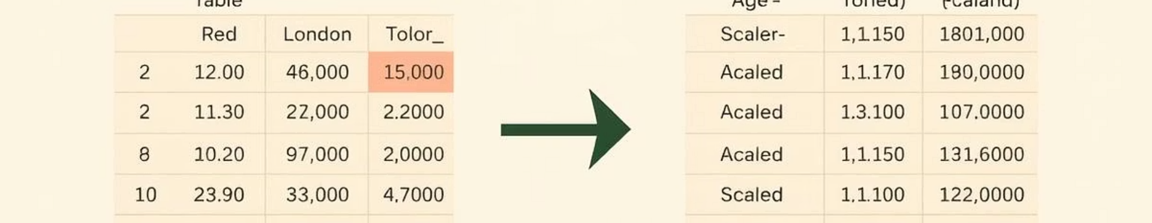
Data Preparation and Cleaning
Handle Missing Data
1
Since missing values appeared only in specific columns related to either mobiles or laptops, we split the base DataFrame into two separate DataFrames - one for mobiles and one for laptops.
Column Filtering
2
Removed unnecessary columns for streamlined analysis.
Data type conversion
3
converted relevant columns to appropriate data types - such as transforming date columns to datetime format and memory values to numeric types.

Slide 10
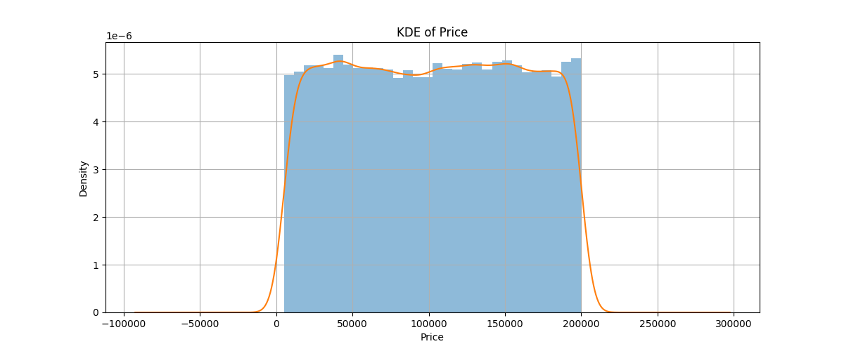
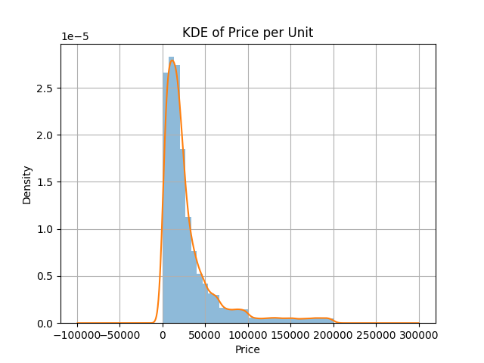
Descriptive Statistics
 | Quantity Sold | Transaction Price | Product Price
Mean | 5.51378 | 102641.407080 | 30051.675203
Standard deviation | 2.88101 | 56363.550361 | 35002.698708
Min | 1.0 | 5008.0 | 503.2
Max | 10.0 | 199999.0 | 199999.0
Median | 6.0 | 103072.0 | 18621.83
Variance | 8.300216 | 3.1768e+09 | 1.225189e+09

Slide 11
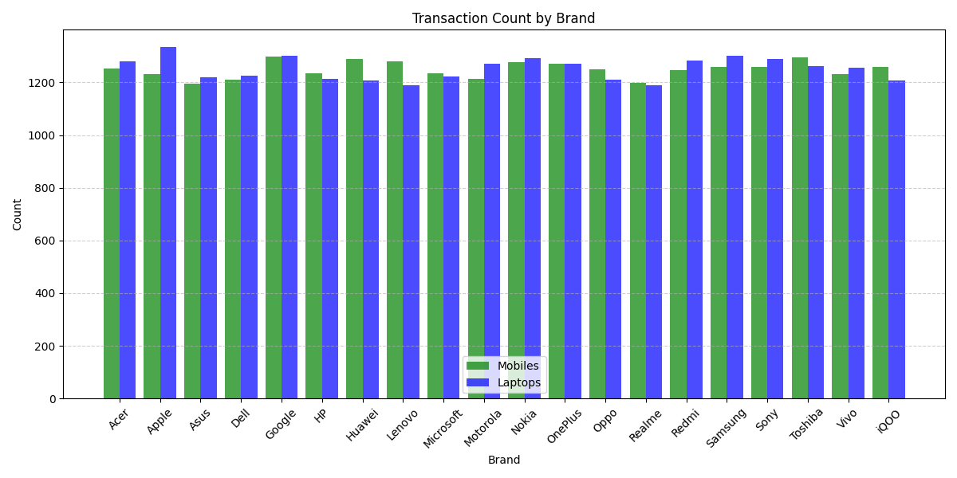
Descriptive Statistics

Slide 12
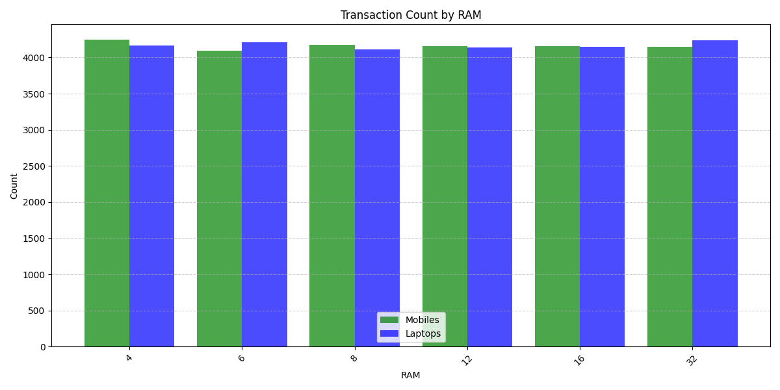
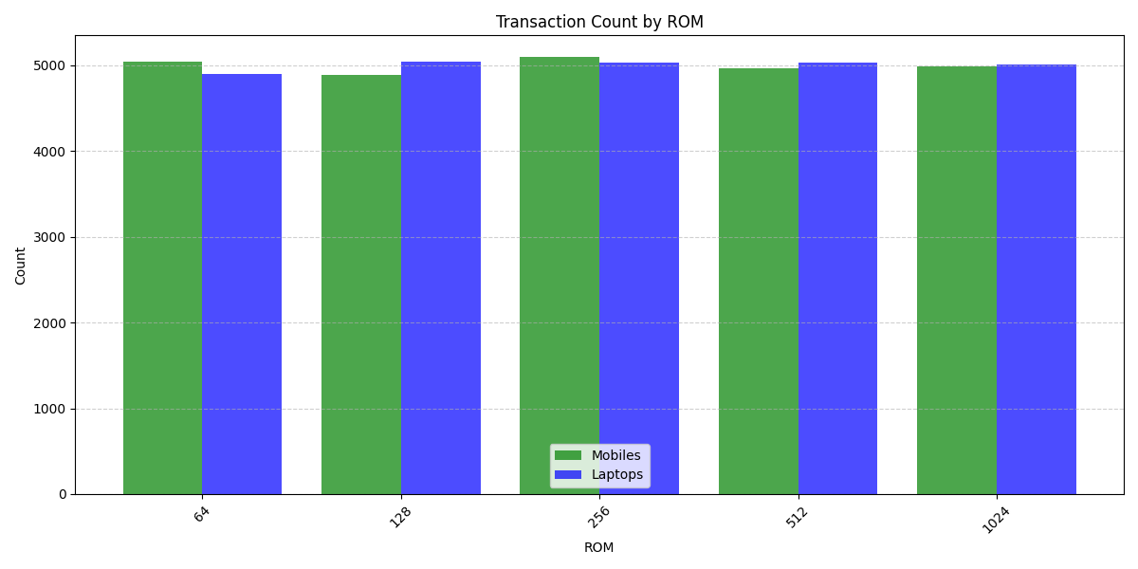
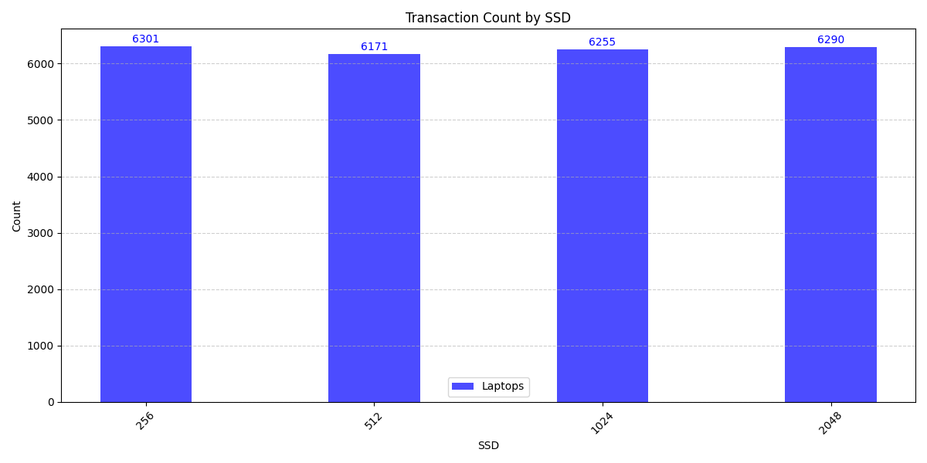
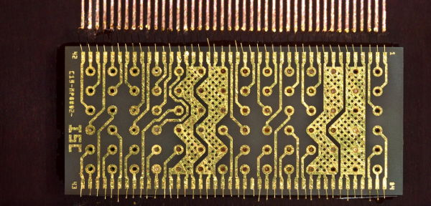
Descriptive Statistics

Slide 13
Data Transformation
1
Categorical Encoding
2
Data Scaling
3
Feature Engineering
Transform categorical variables into numerical representation (one-hot, label encoding, etc.).
Normalize or scale numerical data to achieve a consistent range for easier comparison and analysis.
Create new features based on existing ones to capture hidden relationships and improve predictive accuracy.

Slide 14




Data Exploration and Insights
Statistical Summary
Distribution Plots
Categorical Analysis
Visualize the distribution of numerical variables using histograms, Kernel Density Estimation (KDE), etc.
Calculate mean, median, variance, etc., to understand the distribution and central tendency of variables.
Explore categorical variables using bar plots to understand frequency and distribution.

Slide 15



Major Findings
Groupby()
1
Summarize data based on groupings.
Pivot Tables
2
Create multi-dimensional tables for cross-tabulation and analysis.
Insights
3
Identify patterns, trends, and relationships within groups.

